Slide 1
Literature mining, ontologies and information visualization for drug repurposing
Christos Andronis, Anuj Sharma, Vassilis Virvilis, Spyros Deftereos and Aris Persidis
17th November 2010

Slide 2
TECHNOLOGICAL OVERVIEW
Literature mining
Information Extraction (IE)
Semantic web technologies and ontologies
Finding inferences through visualization techniques

Slide 3
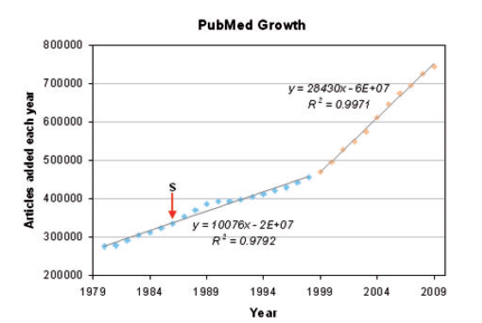
Literature Mining
PubMed is…
the most widely used repository of biomedical articles.
containing over 20 million abstracts.
growing rapidly.

Slide 4
Literature Mining
Swanson’s ABC model
The premise is that there are two concepts of knowledge that do not communicate explicitly with each other
Finally established in the clinical practice.

Slide 5
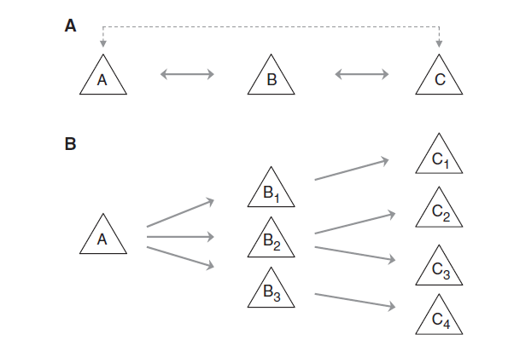
Literature Mining
Swanson’s ABC model : 2 types
Closed Process
Open

Slide 6
Semantic web technologies and ontologies

Slide 7
CONCLUDING REMARKS

Slide 8
KeyPoint
The productivity challenge of traditional drug discovery, has sparked a renewed interest to DR, as an alternative approach to traditional drug discovery.
As research on a single topic may be spanning across many scientific disciplines and biomedical journals, it is increasingly difficult for scientists to follow all advances in their field of interest. Advances in literature mining have made it possible to infer relationships between biomedical concepts, even if they are not mentioned in the same abstract.
Biomedical literature mining, especially the combination of efficient IE with LBD seems to be well suited as a strategy to generate scientific hypotheses related to finding new uses for existing drugs.
Ontologies capture domain knowledge, concepts and their relationships, and have been used to infer unknown relationships, throught automated reasoning , making them indispensable in drug repurposing.
Visualization techniques in articles relevant to drug repurposing are either used to conceptualize an automatic algorithm for detection of an association of interest or simply act as an exploration tool to manually perform the dectection.

